Slide 1
B7.1.1.1.1 Discuss the fourth-generation computers
Discuss features of fourth generation computers

Slide 2
Features of fourth generation computers
It was produced in the 1970
It was designed using microprocessor technology.
The fourth generation computers were very small in size,
They were also portable.
It produced very low amount of heat.
They were more reliable because they were much faster and accurate.
They were much cheaper to buy compared with the previous generation of computers.

Slide 3
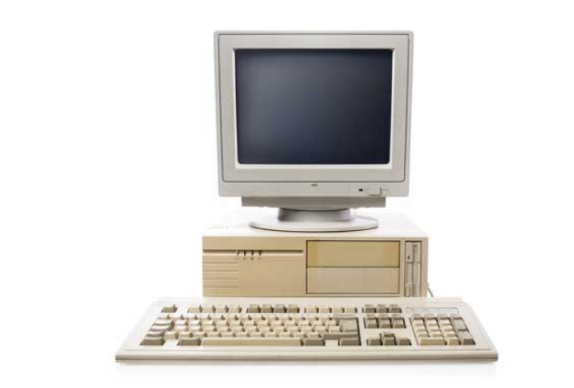
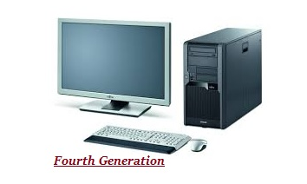
Features of fourth generation computers

Slide 4
End of Slides

