Slide 1
Examine the uses of the output devices: Graphing plotter, Data and Multimedia Projectors, Pico projector
1. Watch video or pictures of output devices in use.
2. Demonstrate the use of output devices in a computer laboratory/classroom
3. Explore the advantages and disadvantages of output devices

Slide 2
Graphing plotter
A plotter is an output device used to create high quality , large –format graphic and drawings.
They are available in various types and use.

Slide 3
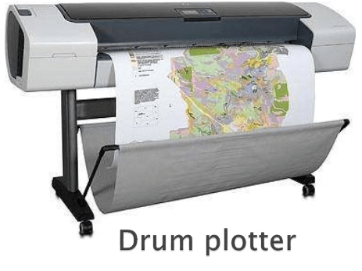
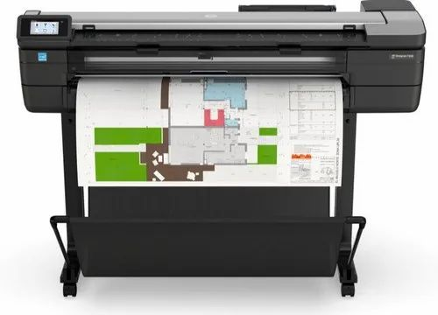
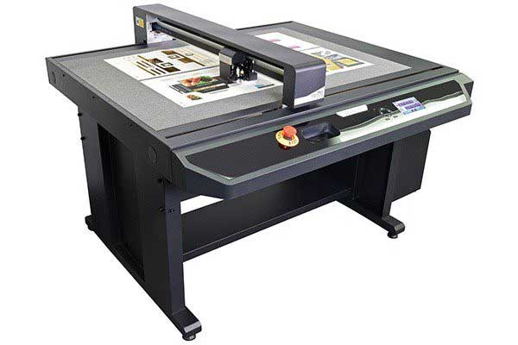
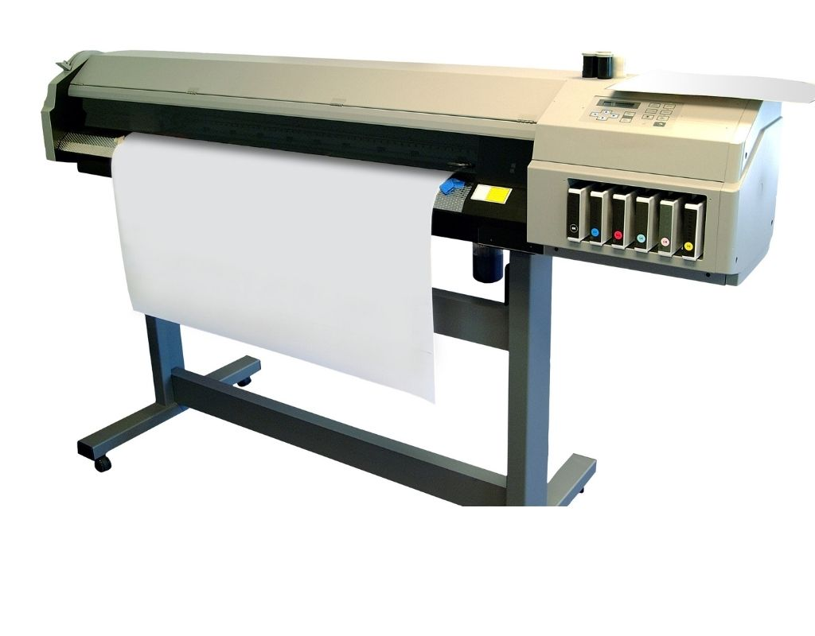
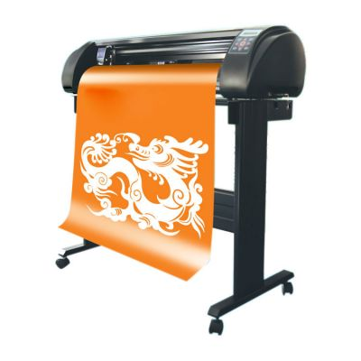
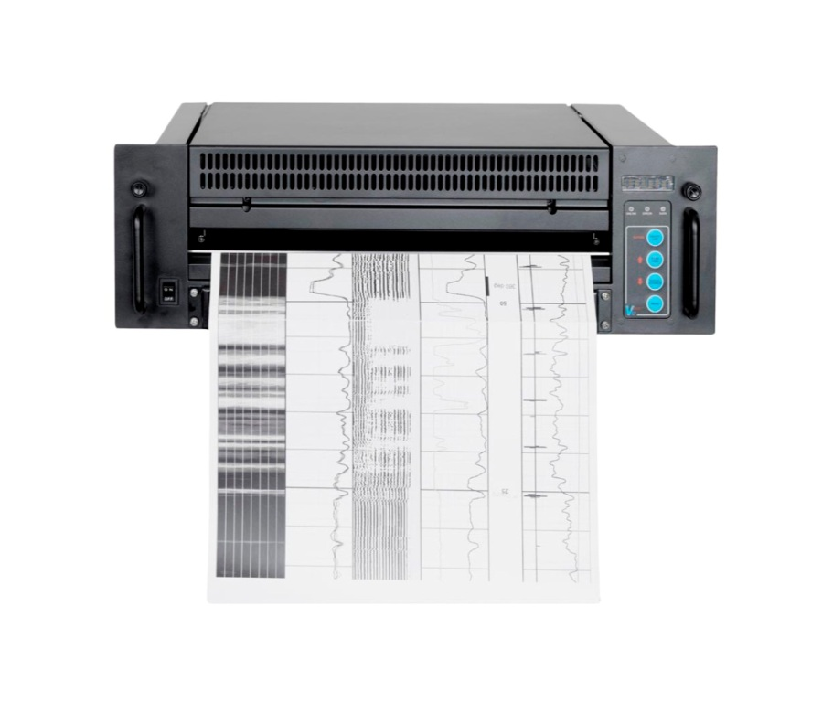
FLATBED PLOTTER
Types of Graphing plotter
DRUM PLOTTER
INK JET PLOTTER
ELECTROSTATIC PLOTTER
CUTTING PLOTTER
THERMAL PLOTTER

Slide 4
FLATBED PLOTTER
Flatbed plotter has a flat surface on which the paper is placed.
It is one of the most popular types of plotters among users.
It is used for printing Graphic design and illustration
Signage and packaging

Slide 5
DRUM PLOTTER
The paper on which we will create the drawings on is wrapped around a drum.
Drum plotter is used for printing engineering and architecture works
For printing maps.
For printing posters and graphics that are artistic.
For printing charts.

Slide 6
INK JET PLOTTER
An inkjet plotter is a type of plotter that employs inkjet technology to print high-quality graphics and images on a variety of media.
Drum plotter is used for printing engineering and architecture works
For printing maps.
For printing posters and graphics that are artistic.
For printing charts.

Slide 7
ELECTROSTATIC PLOTTER
An electrostatic plotter is a type of plotter that generates graphics using electrostatic principles.
Printing drawings for architecture and engineering.
For printing Maps.
For printing diagrams and images for technical purposes.
For printing circuit boards.
Document and blueprint reproduction.

Slide 8
Thermal Plotter
A thermal plotter is a type of plotter that produces graphics on heat-sensitive paper using thermal technology.
It is used for printing engineering and architecture works
For printing maps.
For printing posters and graphics that are artistic.
For printing charts.

Slide 9
CUTTING PLOTTER
A cutting plotter is a specialized instrument used for cutting out shapes and designs.
Production of decals and stickers Fashion and textile design deals with much cutting

Slide 10
General uses of Graphing plotter
We use plotter for printing construction maps and building plans,
Plotters are used in textile printing.
They are mostly used to make billboards and banners.
They can be used to draw geographical layout.
Plotters are used to make electrical circuit layouts.

Slide 11
Advantages of Graphing plotter
They can draw on other materials such as sheet steel, aluminum, plastic, etc.
They can print anything on paper which can helps us to create hard copy of our designs.
Plotters can produce high quality images on even large sheet of paper.
They can help to spread a company as we can’t make any billboard or advertising banner without using plotters.

Slide 12
Disadvantages of Graphing plotter
They are huge and need more space for installation
They are very expensive.
They require high maintenance.
They make noise while printing.
Not portable.

Slide 13
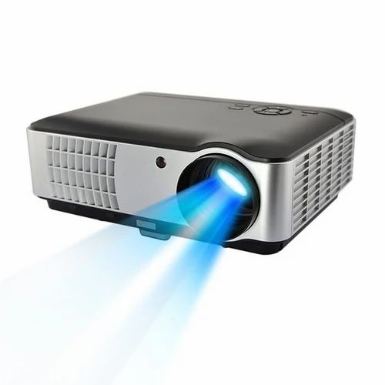
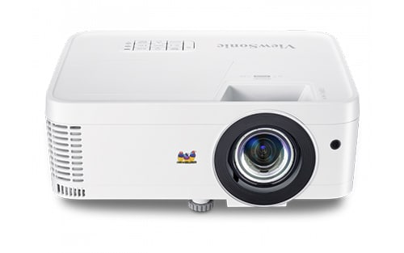
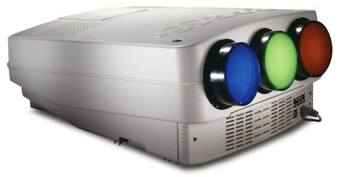
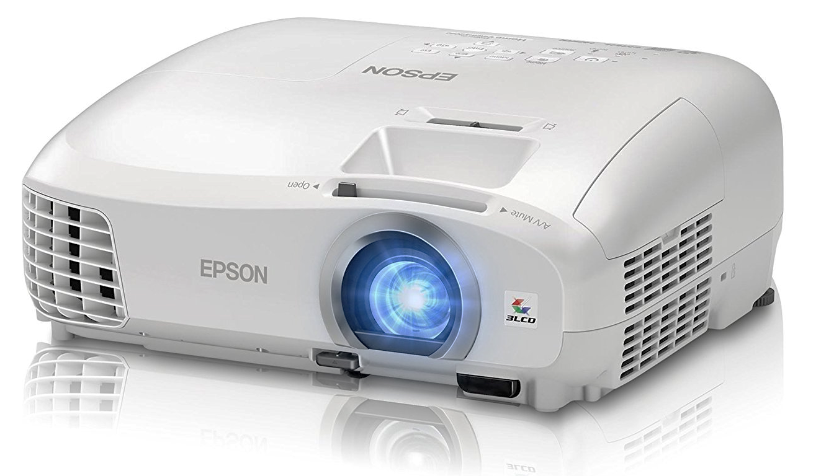
Data and Multimedia Projectors

Slide 14
Data and Multimedia Projectors
A projector is an optical device that projects a figure or picture onto a surface.
Projectors generally have light source, a fan, a reflector ,a slide holder and a lens

Slide 15
Types of Projectors
On the basis of its display property, Projectors can be classified in three types. They are:
Cathode Ray Tube (CRT)
Liquid Crystal Display (LCD)
Digital Light Processing (DLP)

Slide 16
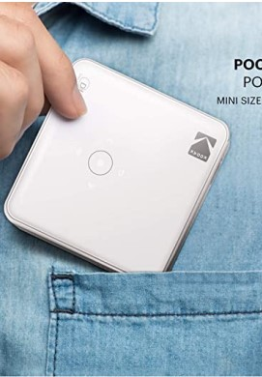
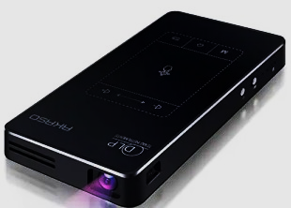
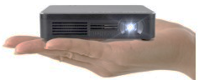
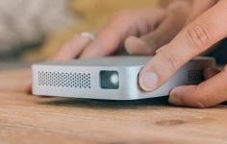
Pico projector
Pico Projectors are small, portable, battery-operated projectors that are designed to project content from your phone or laptop, or even play video files from USB or SD storage.
They are portable,
Pico Projector small in size,
They are very compact and light weighted,
They consume low energy.
Pico Projector may have built-in battery or not,
Batteries can be chargeable or replaceable, depending on the model.

Slide 17
Advantages of Pico projector
Can be connected to WiFi, Bluetooth, and screen mirroring
Low power consumption
Pico projector come with a hard drive and speakers,
A Pico projector is light, compact, and portable.
This projector occupies less space and can be put out when not in use.
It is very easy to set up and easy to use.
This projector can project anything on a wall or a screen.
It is affordable to purchase.

Slide 18
Disadvantages of Pico projector
Pico Projector rely on battery life, thus the long the battery life, the longer its working period.
Pico Projectors do not work better in bright space.
No focusing capabilities
The quality of the image is not that good
Incompatible apps for screen mirroring
Limited audio video settings

Slide 19
General advantages of Projectors
Low Cost
Space Saving
Easy To Install
Largest possible picture.

Slide 20
Disadvantages of Projectors
A dark room is very often required to use a projector.
It requires maintenance on regular intervals.
Installation Cost can be more in some cases as it depends upon how you get it installed.
Most of the projectors need a separate audio system.

Slide 21
Common applications of Projectors
In Classrooms, projectors are used to display, videos or photograph making learning more enjoyable
In Companies, projectors are used for meeting presentations and conference purposes.
At Home Projectors are even used as home theaters that permit you to see the movie on large screen.
Projectors are used at cinemas to display movies on large screens.

