Slide 1
B8.1.1.2.1 Discover temporarily peeking into a window on a Taskbar
Explore features of the Taskbar 2.
Demonstrate the preview of windows on a Taskbar

Slide 2
WINDOWS OPERATING SYSTEMS
Windows operating system (OS) is software program that manages all computer software and hardware.
Without the operating system, the computer cannot be operated and is rendered useless.

Slide 3
WINDOWS OPERATING SYSTEMS
Windows operating system (windows OS) is an operating system designed by Microsoft corporation in the mid 1980s.
Windows OS comes in different versions such as windows 98, windows 2000, windows XP, windows Vista, windows 7, windows 8, windows 10, and 11.

Slide 4
WINDOWS OPERATING SYSTEMS
The current version of windows OS is windows 11.
These windows OS are used more often on personal computer.

Slide 5
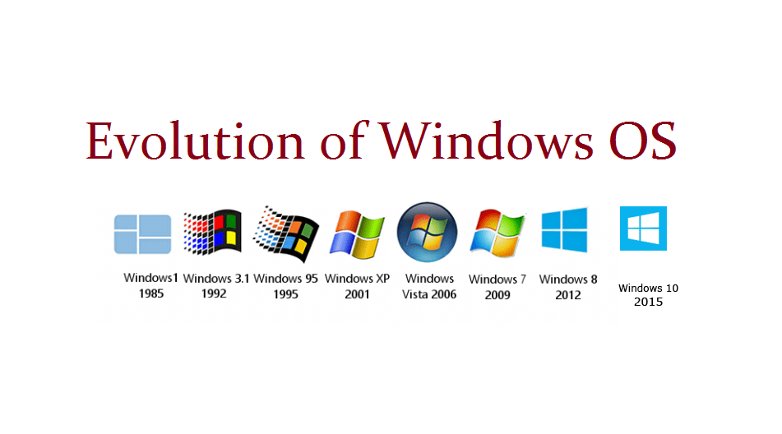
WINDOWS OPERATING SYSTEMS

Slide 6
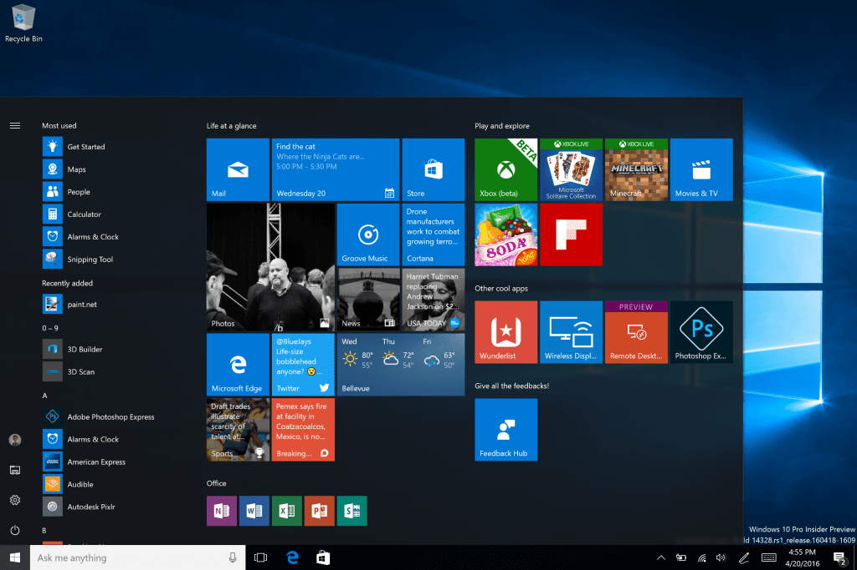
WINDOWS OPERATING SYSTEMS

Slide 7
Taskbar
The Taskbar is the horizontal bar that runs across the bottom of the desktop
OR
A bar at the edge of the display of a graphical user interface that allows quick access to current or favorite application.
It allows the user of the computer to find and launch a program by using the start menu.
The taskbar is also used to view any program that is running or opened.

Slide 8
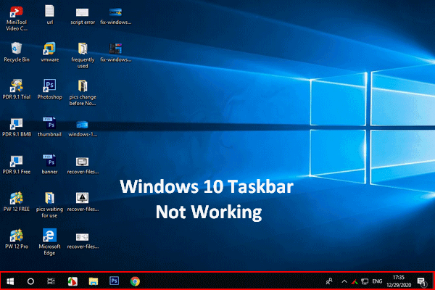
Taskbar

Slide 9
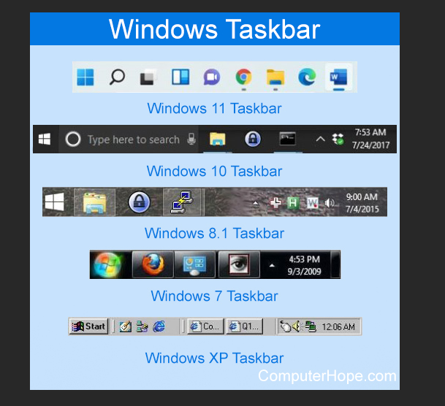

Slide 10
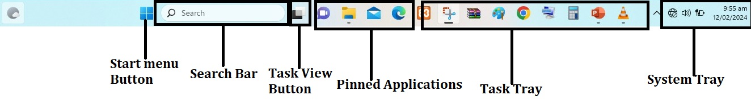
Taskbar

Slide 11
Features of the Task bar
Start menu button
Search bar
Task view button
Pinned applications
Task tray
System tray or Notification area

Slide 12

Start button
It is located on the far left of the taskbar.
It is the first icon on the taskbar from the left.
It is used to access the start menu by clicking on it.

Slide 13

Search box
Next to the windows button is the search box.
It helps to search stuff on the computer and also the web.

Slide 14

Task view button
It is the next icon right after the search box on the taskbar.
It is used to create multiple virtual desktops on which you could perform different tasks and also helps you to switch between them.

Slide 15
Pinned applications
These are applications that remain on the taskbar whether running currently or not.
Some apps are pinned by default which you can unpin by right clicking on it and clicking on “Unpin this program from taskbar”. Pinned apps helps the computer user to open apps that have no icons on the desktop quickly

Slide 16
Task tray
This is the free space on the taskbar after the pinned apps.
It’s function is to display or show currently opened apps.

Slide 17

System tray or Notification area
This is the area on the far right of the taskbar which has up pointing arrow which when clicked on shows icons of apps working in the background.
It also shows the laptop’s battery level.
It displays network connections icon, volume icon, notifications icons, time & date.

