Slide 1
Practice File Management Techniques
(Users & Accounts)
Explore different account levels for users of computer systems.
2. Explore different permission levels applied to files and folders

Slide 2
FILE MANAGEMENT TECHNIQUES
A file in computing is an object that stores, information, settings, or commands used with a computer program.
A file is created using a software program on the computer.

Slide 3
FILE MANAGEMENT TECHNIQUES
A file management, also known as file systems, is a method of organizing and retrieving file from a storage medium.
File systems usually consist of files separated into groups called directories.
Directories can contain files or additional directories.

Slide 4

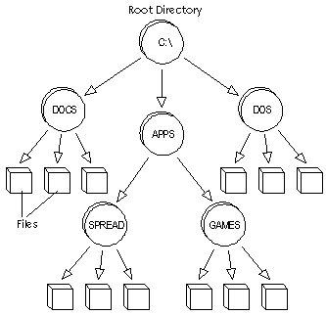
FILE MANAGEMENT TECHNIQUES

Slide 5

Class Discussion
What is an Account?

Slide 6
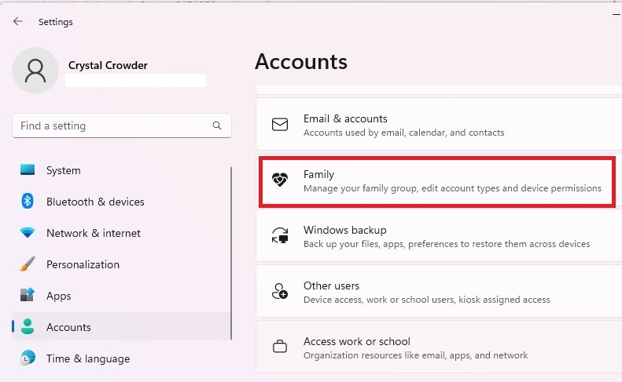
Computer User account

Slide 7
Computer User account
A user account is a collection of settings and permissions, specific to each user, that determine what the user can and cannot do on the computer.
There are three levels of user account , each designated to enable or restrict changes to a computer’s setting and programs.

Slide 8
Administrator
Administrator account is an account that has the most control over a computer .
The account can be used for making changes to system settings or managing other people's accounts.

Slide 9
Standard
Standard accounts are the basic accounts you use for normal everyday tasks.
This account level allows users to do just anything you would need to do, such as running software or personalizing your desktop.

Slide 10
Guest accounts
Guest accounts are intended primarily for people who need temporary use of a computer.

Slide 11
Why use separate user accounts?
If you're sharing a computer with multiple people, for example, with your family or at the office user accounts allow everyone to save their own files, preferences and settings without affecting other computer users.
When you start your computer, you'll be able to choose which account you want to use.

Slide 12

PERMISSION LEVELS APPLIED TO FILES AND FOLDERS IN WINDOWS OS
There are six standard permission types which apply to files and folders in windows;
Full control
Modify
Read & Execute
List folder contents
Read
write

Slide 13
Full Control
Permits the user(s) to:
View file name and subfolders.
Navigate to subfolders.
View data in the folder's files.
Add files and subfolders to the folder.
Change the folder's files.
Delete the folder and its files.
Change permissions.
Take ownership of the folder and its files.

Slide 14
Modify
Permits the user(s) to:
View the file names and subfolders.
Navigate to subfolders.
View data in the folder's files.
Add files and subfolders to the folder.
Change the folder's files.
Delete the folder and its files.
Open and change files.

Slide 15
Read & Execute
Permits the user(s) to:
View file names and subfolder names.
Navigate to subfolders.
View data in the folder's files.
Run applications.

Slide 16
List Folder Contents
Permits the user(s) to:
View the file names and subfolder names.
Navigate to subfolders.
View folders.
Does not permit access to the folder's files

Slide 17
Read
Permits the user(s) to:
View the file names and subfolder names.
Navigate to subfolders.
Open files.
Copy and view data in the folder's files.

Slide 18
Write
The Read permissions permits the user(s) to:
Create folders.
Add new files.
Delete files.

