Slide 1

Demonstrate how to apply Health and Safety measures in using ICT Tools

Slide 2
Computing –Related Disorders
The long – term use of computers has been linked to range of health problems which are called computer-related disorder.
Some of these health disorders include;
  Repetitive strain injury
  Eye strain
  Deep vein thrombosis
  Stress
  Computer vision syndrome
  Carpel tunnel syndrome
Obesity
Neck pain
Motion injury
Back injuries

Slide 3

Computer radiation
Computer radiation is the electromagnetic wave that is emitted by the computer .
Effect of Computer Radiation
Heat waves from laptops can cause skin burns and wrinkled skin
Computer radiation can cause infertility, especially when placed near the reproductive organs.

Slide 4
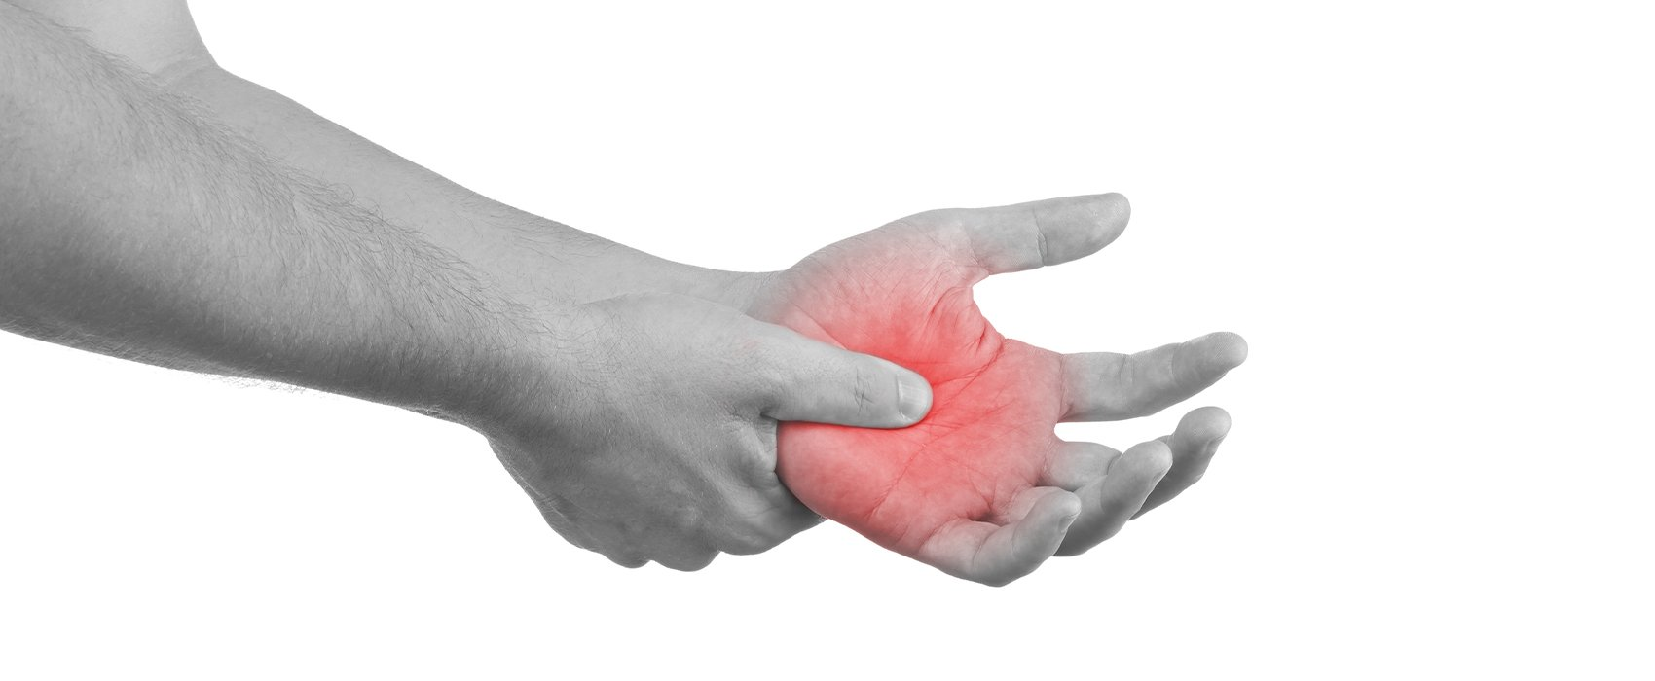
Repetitive strain Injury

Slide 5
Repetitive strain Injury
Causes
Typing or using mouse for long periods
Using too much force on your fingers when typing
Using a poor-designed keyboard
Bad posture workstation chairs and tables giving the arms unnatural position.
Symptoms of RSI
Pain in arms/wrists even after rest.
Weakness/Numbness/ stiffness in arm/wrist
Burning sensation in the shoulder and neck.
Prevention
Use wrist rests to support wrist
Observe a five-minute break from typing at lease every hour.
Adjust chair height to give arms natural rest when working.

Slide 6

Eye Strain

Slide 7
Eye Strain
Eye strain is when the eye becomes tensed after staring at a computer screen for a long time.
Symptoms of Eye strain
Burning or itching eyes
Blurring or double vision
headache
Nausea
Eye fatigue
Eye irritation
Prevention
Use monitor which do not flicker
Use a screen filter
Take regular breaks

Slide 8
Back and Neck Pain
Back and neck pain are problems that occur due to poor posture while sitting at a computer.
Symptoms
Stiff back and neck
Back and neck pains
Headaches
Prevention
Use fully-adjustable chair
Use footrest to keep feet at natural angle.
Use adjustable monitor
Take regular break from work
Sit with the back straight and head up.

Slide 9
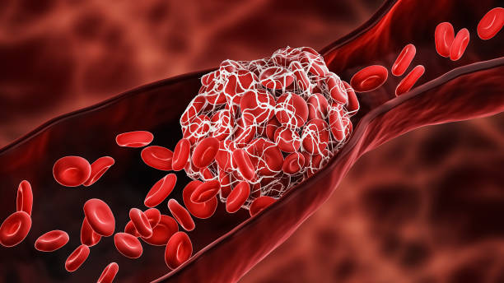

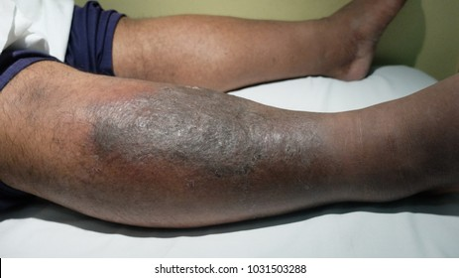
Deep vein thrombosis
DVT happens when compressed deep vein is not able to return blood to the heart , forming blood clots.
This occurs from prolonged sitting or long period of inactivity.
When bits of these clots form breaks off and travels to the brain ,it can result in a stroke.

Slide 10
Symptoms of Deep Vein thrombosis
Swelling in the affected leg.
Localized heat in the affected leg.
Pain in the affected leg.
Prevention of Deep Vein thrombosis
Take regular breaks.
Stand up and move around to allow the blood flow in your legs to return to normal.
Use an adjustable chair and ensure that your feet are firmly on the floor.
Sit with a suitable posture-do not cross your legs for a long period.

Slide 11

Computer Vision Syndrome
Computer vision syndrome describe a group of eyes and vision related problems that result from prolonged use of devices with screens such as Desktop, laptop, tablets, smart phones, etc.
Causes of Computer Vision Syndrome
Reflections or glare bouncing off the screen.
Poor screen lighting.
Being too close or too far from the screen.
Stirring at a screen for a long period of time.

Slide 12
Symptoms of Computer Vision Syndrome
Eye strain
Dry and itchy eyes
Blurry vision
Difficult in focusing
Short-sightedness-myopia
Headaches
Neck and shoulder pain and stiffness.
Backache.
Prevention of Computer Vision Syndrome
Using antiglare screen.
Ensuring adequate lighting at the workstation.
Blink regularly enough to avoid eye dryness when at work.
Sitting comfortably with both feet flat.
Taking regular rest breaks

Slide 13

Carpal Tunnel Syndrome
This is a common condition that causes pain, numbness and tingling in the hand and arm.
Causes of Carpal Tunnel Syndrome
CTS is normally causes by pressure on the nerve due to prolonged use of a computer keyboard and mouse.

Slide 14
Symptoms of Carpal Tunnel Syndrome
Burning sensation, tingling ,itching ,numbness in your palm and thumb or your index and middle fingers.
Weakness in your hand and trouble holding things
Tingling that moves up into your arm
Shock-like feeling move into your fingers.
Prevention of Carpal Tunnel Syndrome
Using correct sitting posture when working on the computer
Taking regular rest breaks when using the computer.

Slide 15
Other potential computer-related disorders
Obesity
Neck strain
Motion injury
Back injuries
Stress

