Slide 1
B8.1.1.1. Identify parts a computer and technology tools
Discuss the fifth generation of computers with emphasis of on quantum computing

Slide 2
Features of the fifth generation of computers
Fifth generation computers were designed in the year 2010
The computers of the fifth generation had high capability and large memory capacity.
Fifth gen. computers are faster compared to fourth gen.
It can perform multiple tasks at the same time.
Fifth gen. computers were built with some advanced technologies such Artificial intelligence, Quantum computation, Nanotechnology, Parallel processing, etc.

Slide 3
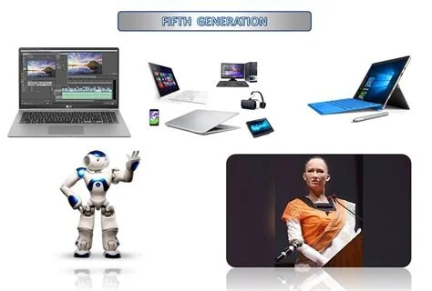
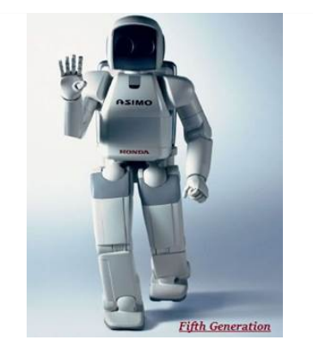
Fifth generation of computers

Slide 4
Definition of terms
Quantum computing is a type of computation that uses quantum physics(superposition and entanglement) to solve complex task.
Superposition is the use of qubits( i.e both 0 and 1.) to process data.
Regular computers handle data in the form of 0s or 1s called bits.
Superposition principles uses both 0 and 1 at the same time making quantum computers extra fast and powerful.
Entanglement means two qubits are entangled into existing as a single quantum state.

Slide 5
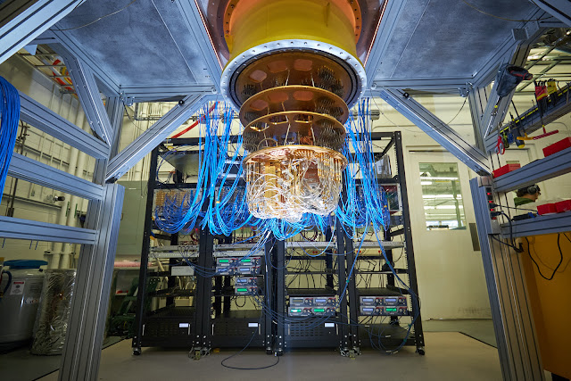
Google Sycamore quantum Computer in progress

Slide 6
Definition of terms
Parallel computing is a type of computing in which several processors simultaneously execute multiple smaller calculations broken down from an overall larger complex problem.
Artificial intelligence is the simulation of human intelligence processes by machines especially computer systems.
Nanotechnology is a field of science and engineering that focuses on the design and manufacture of extremely small devices and structures.

