Slide 1
INDICATOR
Describe Storage devices: Flash Memory
Storage Systems, Embedded Flash Memory
Cards and Readers USB Flash Drives, Solid
State Drives and Hybrid hard drives.
EXEMPLAR
1. Illustrate the use of flash memory Storage Systems,
Embedded Flash Memory, Flash Memory Cards and Readers, USB Flash Drives, Solid State Drives and Hybrid hard drives.
2. Discuss features of Flash Memory Storage Systems,
Embedded Flash Memory Flash Memory Cards and Readers

Slide 2
Examine Storage portable hard drives, Optical Discs and Drives.
E. g. Read-Only Optical Discs: CD-ROM, DVD-ROM, and BDROM Discs Recordable Optical Discs: CD-R, DVD-R, DVD+R, and BD-R Discs Rewritable Optical Discs: CD-RW, DVD-RW, DVD+RW, and BD-RE Discs Exemplar
Identify portable hard drives/Optical Discs and Drives or picture of items to class
2. Discuss features of hard drives/Optical Discs storage media
3. Explore the maximum capacities of these storage devices
4. Explore the different write speeds of these storage devices

Slide 3
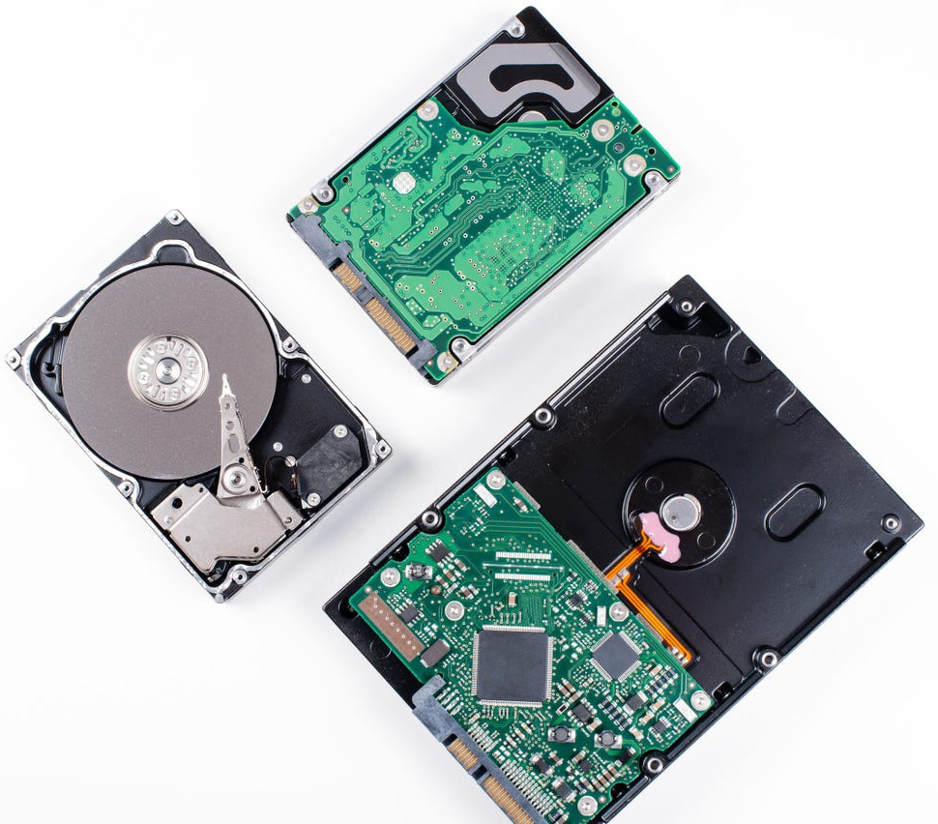
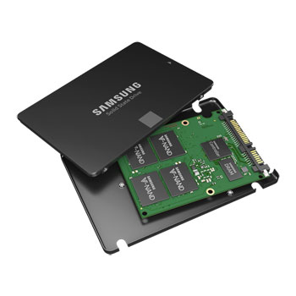
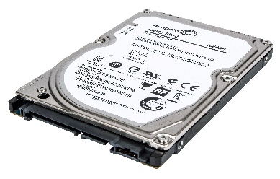
HARD DISK DRIVE

Slide 4
HARD DISK DRIVE
A hard disk drive (HDD) is a hardware device that permanently stores and retrieves data on a computer.
It consists of one or more platters to which data is written using a magnetic head inside an air-tight case

Slide 5
Types of HARD DISK DRIVE
There are two types of HDD. -Internal and external.
The internal HDD is installed inside the computer
The external HDD is a portable HDD outside the computer which is used to transfer data from one computer to another computer.

Slide 6
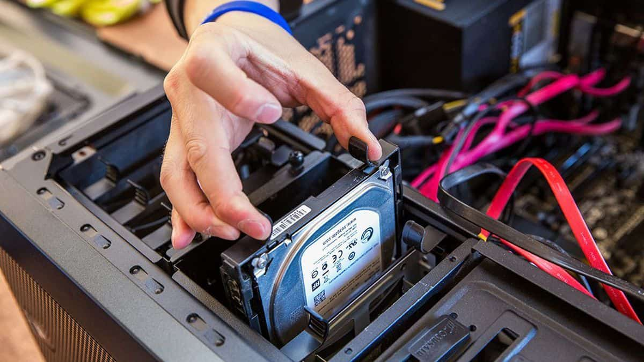
Internal Hard Disk
The internal hard drive is a key component of a computer since it stores the user, ‘software and personal files.

Slide 7
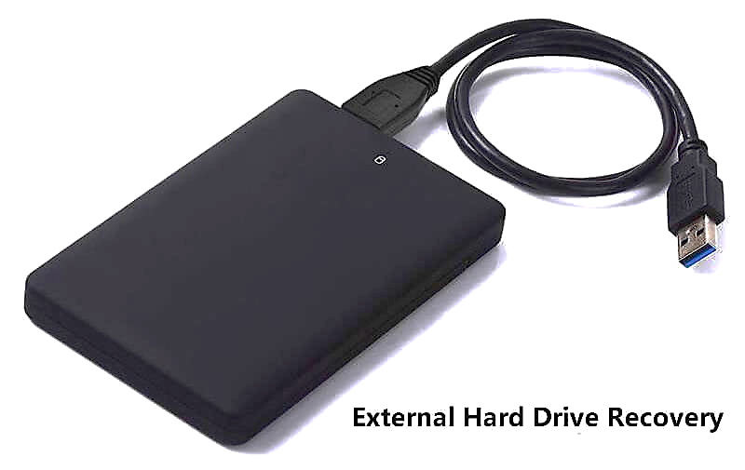
External Hard Disk
External hard disk drive comes in a case that connects to your computer with USB cable. This allows you to add and remove a particular disk as needed or have multiple external drives connected to your system.

Slide 8
Part of a Hard Disk Drive
Platters - hold written binary data.
The spindle - spins the platters spin at high speed
The head –uses electromagnets to read and write data.
Actuator arm - moves the heads across the platter surfaces
Actuators axis - is a small spindle that permit the motion of the read-write arms.
Actuators - move the actuator arms accurately.
External plug connectors - (integrated Development Environment –IDE).

Slide 9
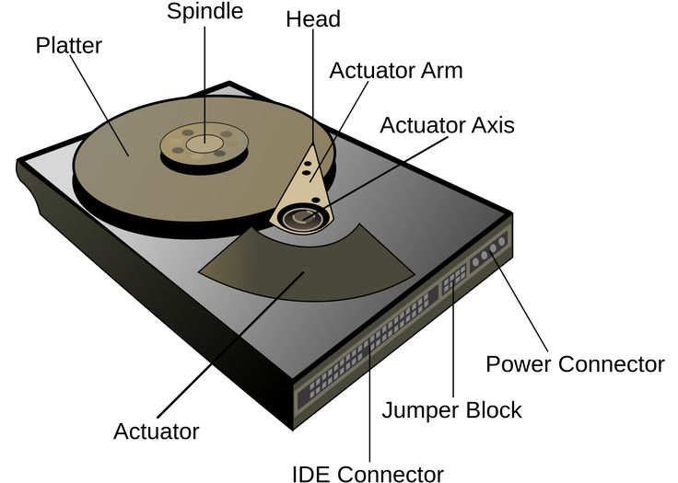
Part of a Hard Disk Drive

Slide 10
How a Hard Drive Works
The hard drive contains a spinning platter with a thin magnetic coating.
As the head moves over the platter, it then writes data in the form of writing zeros (0) and ones (1) as tiny magnetic poles on the platter which is stored.
To read the data, the head goes to the same spot, notices the poles and read the data in the form of Zeros (0) and ones (1).

Slide 11
Hard Drive Speed
The speed of the hard disk drive depends on the rotational speed of the spindle motor.
The speed of the HDD is measured in revolutions per minute (RPM).
The faster the platter spins, the faster an HDD can perform.
If a Hard disk has 5400 or 7200 RPM (Revolution per Minute). It means in a minute, the Hard Disk Drive can make spins 5400 or 7200 in 1 minute

Slide 12
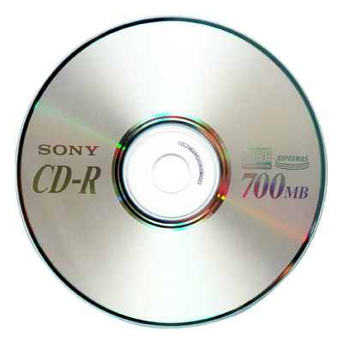
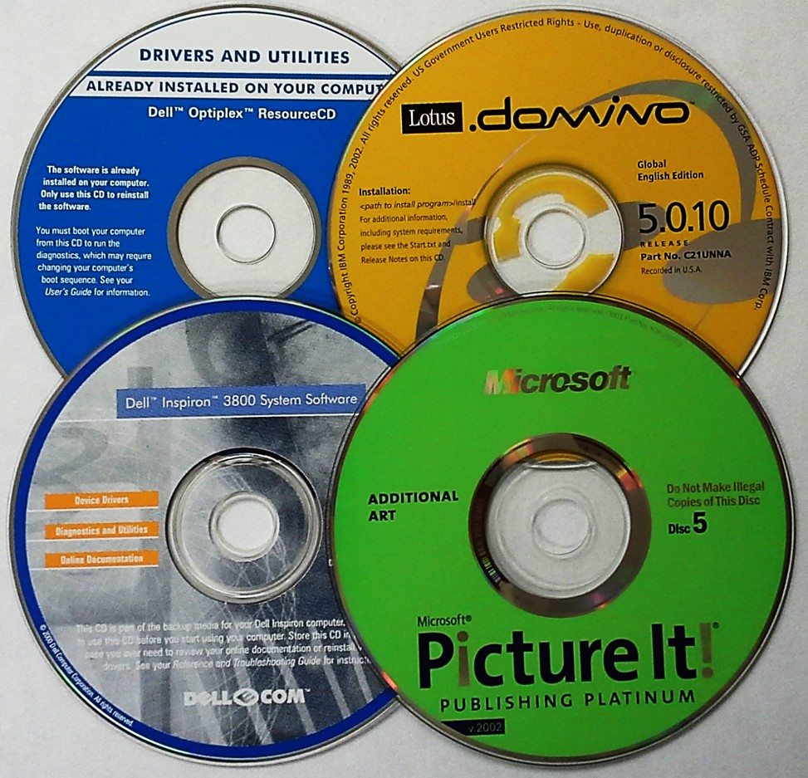
COMPACT DISC

Slide 13
FEATURES COMPACT DISC
Compact disc is an optical storage device used to store data.
These CDs are circular in shape and can store data and information of around 650 MB
IT was invented by American physicist James Russell in August 1982.

Slide 14
FEATURES COMPACT DISC
Sony and Phillip Company were the first to manufacture CDs and made them available to the general public.
They are capable of storing all types of information like images, pictures, videos, software, games, etc.
A special type of device is used to read and write the data of a CD which is known as DVD-RW Digital Versatile Disk Read Write] or CD-RW [Compact Disk Read Write] or CD-ROM [Compact Disk Read Only Memory].

Slide 15
TYPES OF COMPACT DISC
CD-ROM: Read-only memory. The content stored in these types of CDs can only be read but cannot be changed by anyone.
Recordable CD(CD-R): Contents can be written in this media by CD drive attached to a computer or an external CD drive.
CD-RW- CD: Rewriteable.- This means that you can save data to your disk over and over again

Slide 16
TYPES OF COMPACT DISC
CD-Mini: it is about 80 mm. and has a capacity of about 210 mb
CD+R: the “R” stands for recordable. But CD+R was developed by another company to increase(Twice) the capacity of the CD-R
CD-interactive. Released in 1993, CD-i could be played on CD players, but not in a CD-ROM drive. The format was later modified to be read by both.

Slide 17
TYPES OF COMPACT DISC
CD-ROM extended Architecture. The CD-ROM XA is an extension of the standard CD-ROM that allows audio, video and computer data to be accessed simultaneously.
Photo CD.- the photo CD was created for the express purpose of storing photographs in a digital format that could be accessed and edited on a computer.
Video CD. The video CD, or VCD, was created in 1993. it was created purposely to handle video data but has a much lower resolution than a modern digital video disk (DVD).

Slide 18
Advantages of CDs
Small and portable
Readily available in the market
Very cheap to produce
Most computers can read CDs. If there is no CD drive, a DVD drive can usually read them

Slide 19
TYPES OF DVDs
Digital versatile disc.
DVD-R
DVD-RW
DVD+R
DVD+R DL
DVD-RAM

Slide 20
DVD-R
DVD-R recordable
It is a 4.7 gigabyte capacity,
Write-once recording media format
After the data has been burned to the disc, the content cannot be erased or deleted.
The two main types of DVD-R discs are DVD-R and DVD+R

Slide 21
DVD-RW
DVD-RW- Digital versatile disc -rewriteable
it is a 4.7 gigabyte capacity,
It is rewriteable recording media format which is capable of more than 1,000 rewrites.

Slide 22
DVD+R
DVD+R is a 4.7 gigabyte capacity, write-once recording media format.
After the data has been burned to the disc, the content cannot be erased or deleted.

Slide 23
DVD+R DL
DVD+R DL is the dual-layer version of the DVD+R media.
The main difference between a DVD+R DL and the DVD+R is that the DVD+R DL can store up to 8.5 gigabytes on one disc side, unlike the DVD+R and DVD-R, which have a 4.7 gigabyte capacity.

Slide 24
DVD-RAM
DVD-RAM is a very strong data storage format, theoretically allowing greater than 100,000 rewrites per disc.

Slide 25
Advantages of Optical Storage Media
Fairly fast to access the data - quicker than magnetic tape.
The information stored in the compact disk is stored permanently and can be accessed anywhere anytime.
The data stored on CD is read-only memory, therefore, we can read the data and are unable to delete or update the data and information present inside the CDs.

Slide 26
Disadvantages of Optical Storage Media
Scratches on the disk surface can damage the data being stored
Smaller storage capacity than a hard drive or DVD
Slower to access than the hard disk.
Needs a computer with a CD or DVD drive in order to read the information stored on them.
Needs to be protected from extremes of heat.
Maximum capacity of CD is between 600-700mb which is very limited to use for certain storage.

Slide 27
Comparing HHD and Optical Storage Media in terms of capacity and speed
A hard drive can handle a lot more data on a disk than a CD or DVD.
2. A hard drives spin MUCH faster - a typical hard drive will spin between 5200 and 15000 RPM, while a CD will spin between 200 and 500RPM and a DVD 1530 RPM.

Slide 28
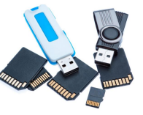
Flash Media

Slide 29
Flash Memory
A flash memory storage system is a non-volatile memory chip used for data storage.(keep data even when power is off)
Data stored flash media can electronically be erased, reprogrammed or rewritten.
It was developed from the EEPROM system(ie. Electronically erasable programmable read-only memory)
Flash memory has no moving parts.
Flash memory Can be grouped into categories: NOR and NAND .
Re-Writable: You can remove the previous data and write a new set of data several times on flash memory.
Simple and Portable: can be carried everywhere.

Slide 30
NOR Flash Memory
Nor flash memory uses individual memory cells to store data.
It is more reliable than NAND
NOR flash memory typically has longer endurance than NAND.
More expensive than NAND

Slide 31
NAND Flash Memory
NAND memory devices uses eight pins to transfer data.
NAND can write to a single memory address at eight bits –one byte at a time.

Slide 32
Examples of Flash Memory
Flash memory cards and reader
USB flash drive
Solid state drives
Hybrid hard drives
Embedded flash memory

Slide 33
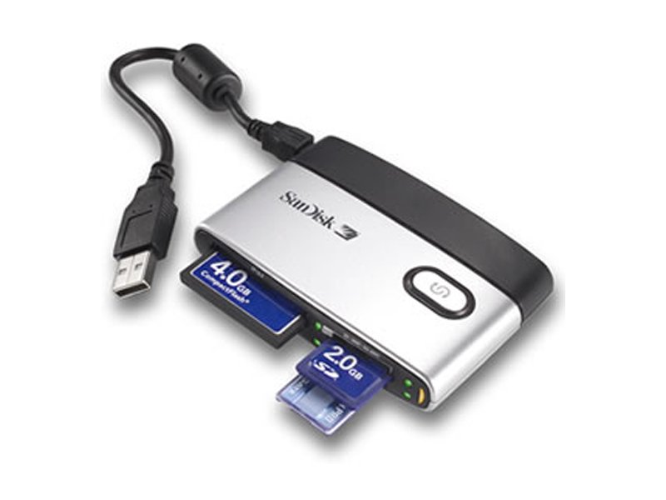
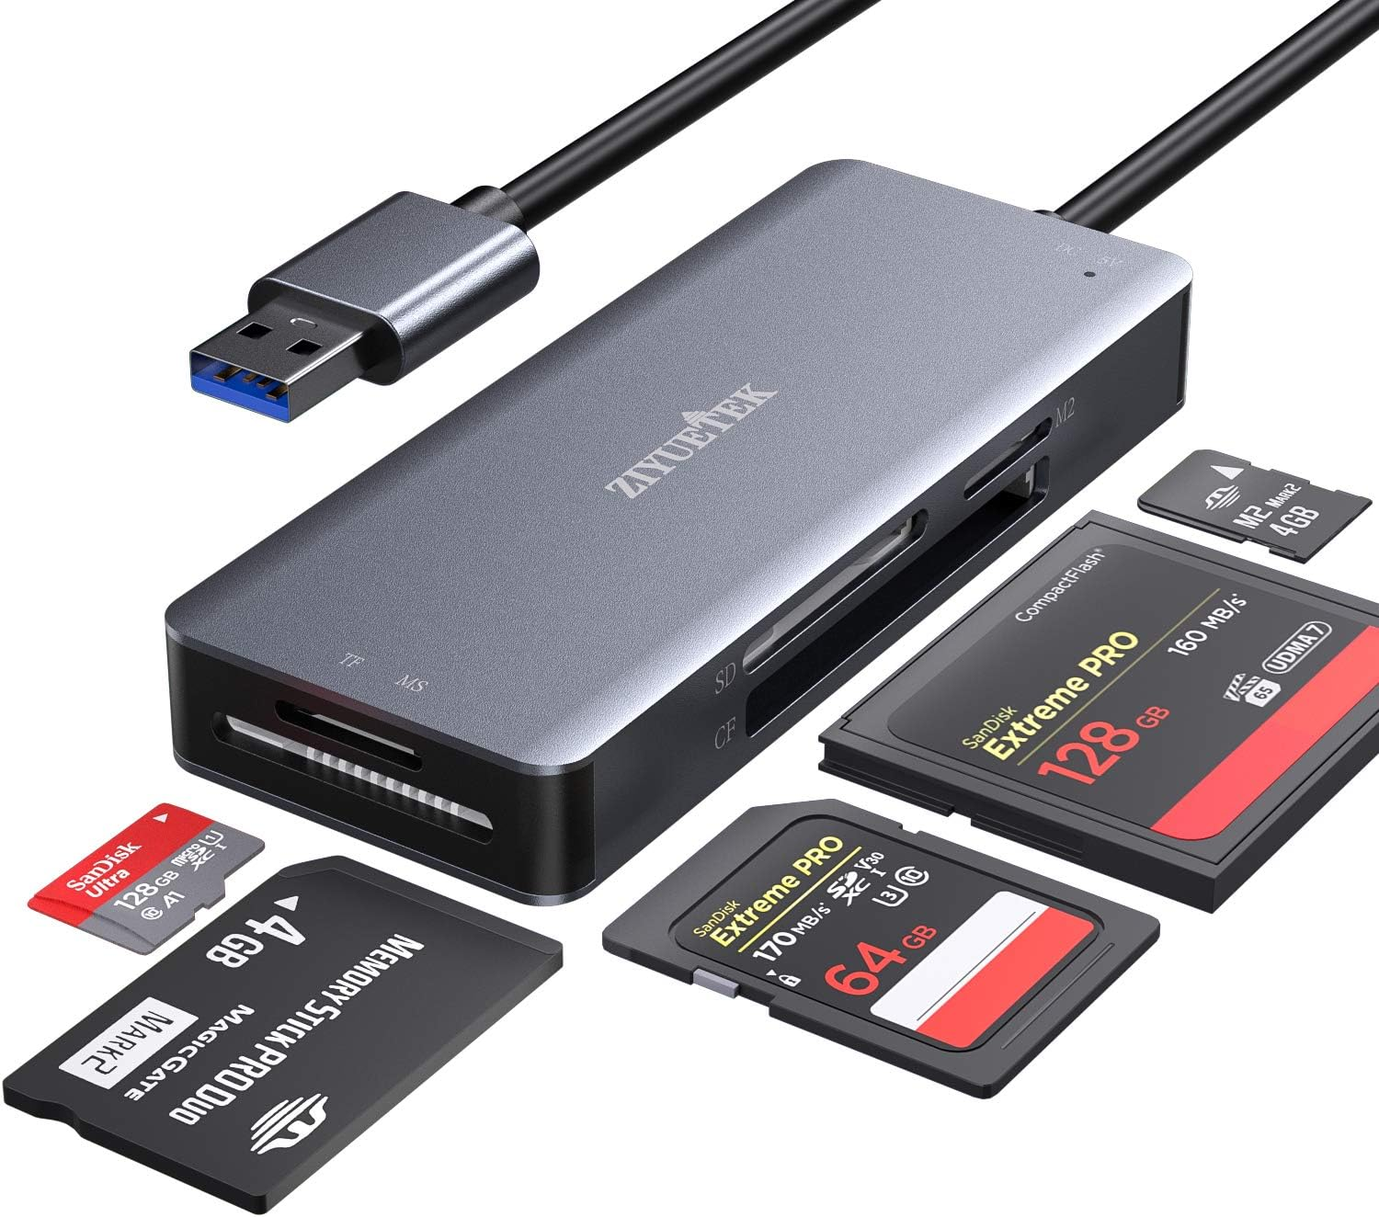
FLASH MEMORY CARDS AND READER

Slide 34
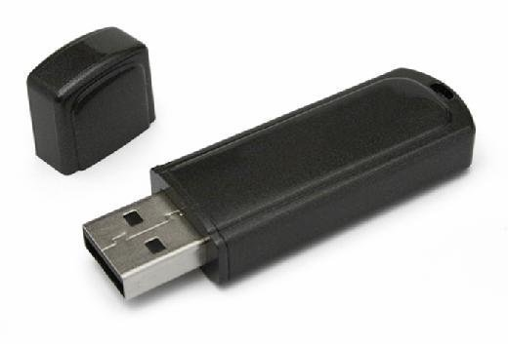
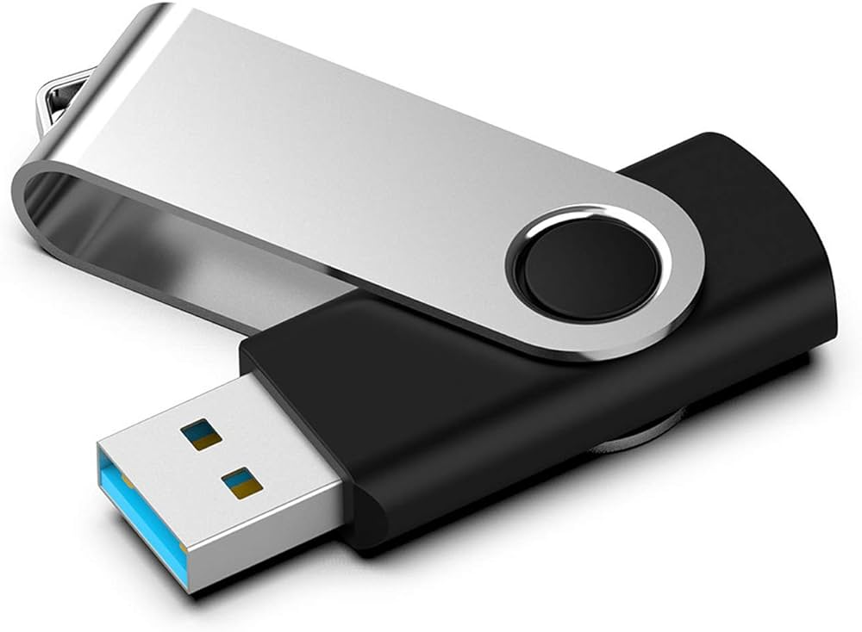
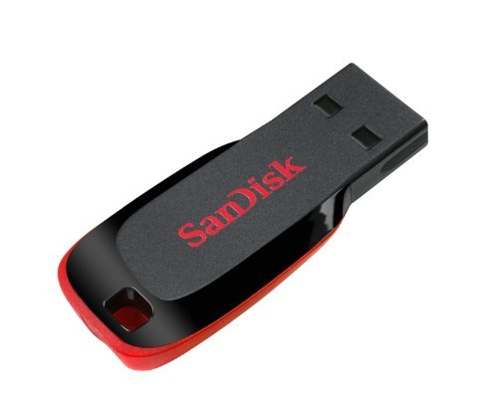
USB FLASH DRIVE

Slide 35
SOLID STATE DRIVE

Slide 36
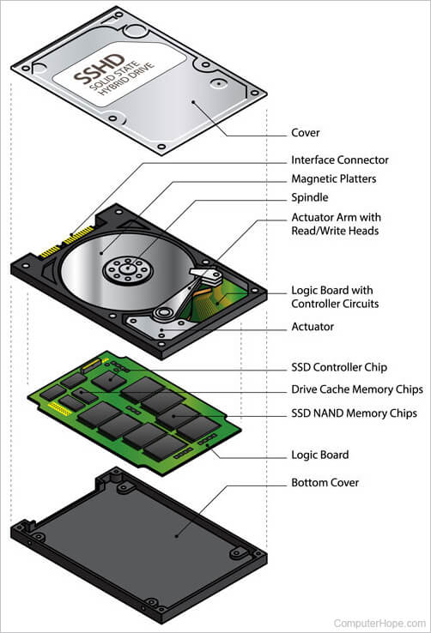
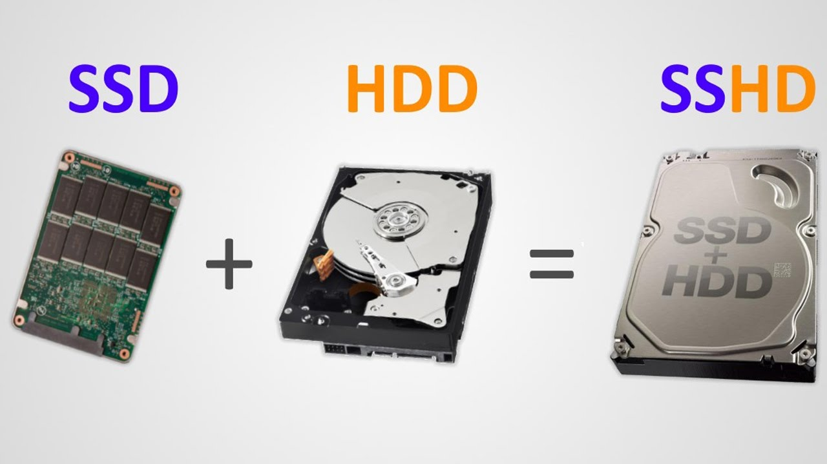
HYBRID HARD DRIVE

Slide 37
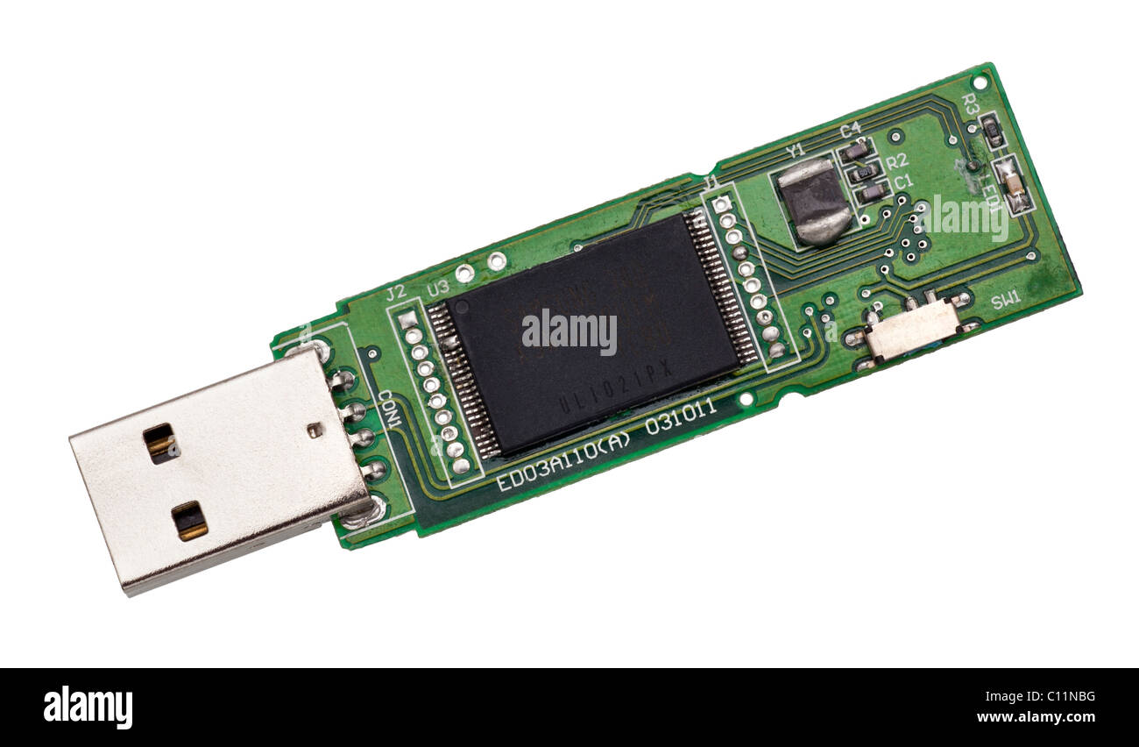
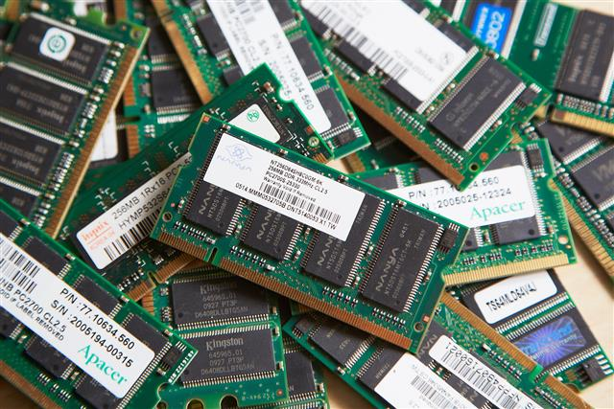
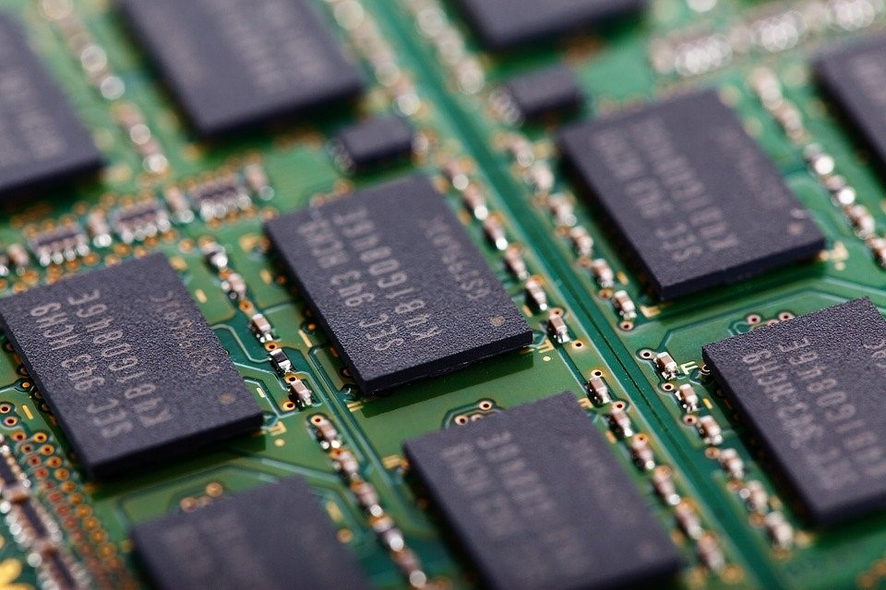
Embedded flash memory

Slide 38
Advantages of flash drives
Faster to read and write compared to Traditional HDD
These storage devices are compact and portable so you can carry them anywhere.
Strong and less prone to damages.
Cheaper.
Use less power compare to traditional HDD.
Easy to connect and use.
Non- volatile.
Not affected by magnetic fields.
Flash Memories are durable as they are shockproof.
Flash Storage Devices are present in both forms, internal and external storage.
Memories are lightweight.

Slide 39
Disadvantages of Flash memory
Have limited number of write/erase cycles before finally failing
Easy to lose due to their small nature
Can easily be infected by computer virus

Slide 40
Examples of Flash Memory
Flash memory cards and reader
USB flash drive
Solid state drives
Hybrid hard drives

Slide 41
Differences between HDD and SSD
HDD
SSD
Has rotating platters and mechanical arms
Read/write speed is slower
Highly fragile
High energy consumption
Slower response time
No moving parts
Read/write speed is faster
Stronger than HDD
Less energy consumption
Quick response time

