Slide 1
Explore the use of the Charms bar.
Identify the icons in the Charms bar
2. Describe features of the Charms bar icons

Slide 2
The charm Bar
The charm bar is a feature of window(8,8.1,10 and 11) windows operation which provide access to windows search, sharing start menu, devices and setting.

Slide 3

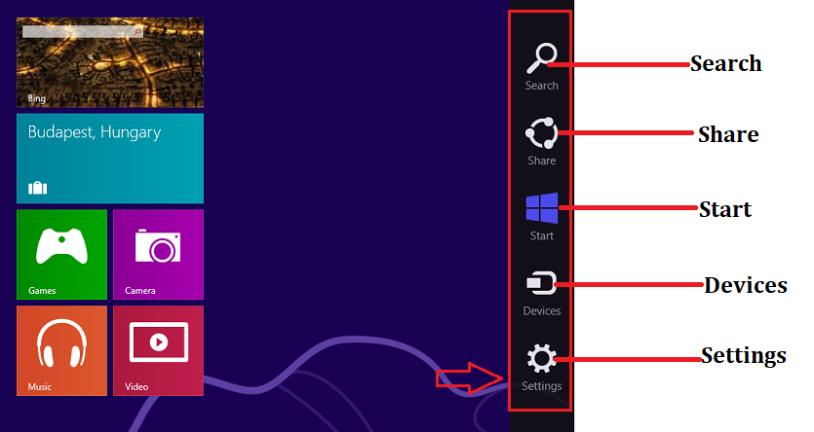
The charm Bar

Slide 4
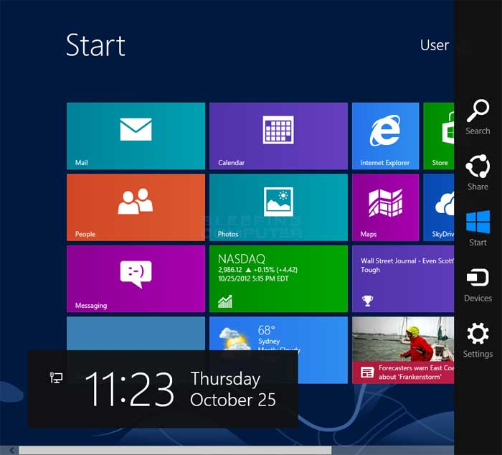
The charm Bar Windows 8 and 8.1

Slide 5
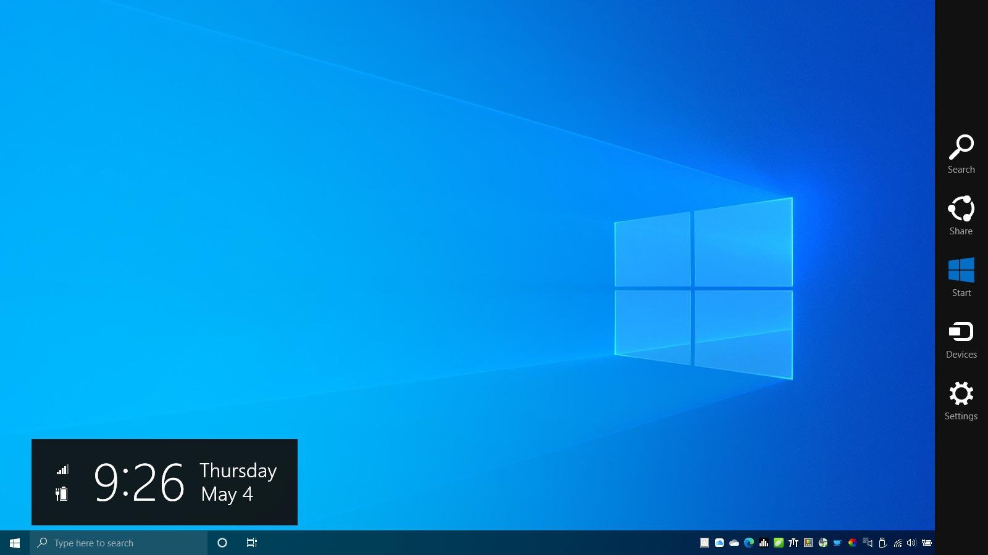
The charm Bar windows 10 and 11

Slide 6
How to display the windows Charm Bar
There are few different methods applying which you can open Charms Bar on Windows 10.
1. Jointly press Windows and C keys of your keyboard. You will see the Charms Bar on right corner edge of your screen.

Slide 7
How to display the windows Charm Bar
2.Users of touch screen systems should swipe to the inner right corner of the screen.
3. If edge swipes are enabled in your touchpad than swipe to the right of your touchpad inwardly.
4. From PC Settings also you can open up the Charms Bar.

Slide 8

Search
To search anything on your computer using this feature.
To use this feature, just press a combination of Windows key and the ’Q’ key.

Slide 9

Share
Share Charms can be obtained by jointly hitting Windows and H key.
You can share your piece of information or any files through the mail app. Or you can even keep a track on your social networking sites.

Slide 10

Start
To get into the Start Menu simply click Windows keys.

Slide 11

Settings
Window and I are the key shortcuts for Settings Charm.
With the Settings Charm, you can change anything related to your PC or apps.
Settings, info, and help options will be there.
General PC Settings items like volume, network connection, power, notifications, brightness and keyboard are also available here.

