Slide 1
Discuss technologies that help to improve computer accessibility
(Adaptive and Assistive Technologies).
1. Identify the categories of people with special needs.
2. Discuss technologies that can be used to help people with special needs (E.g. Computer software and hardware, such as voice recognition programs, screen readers, and screen enlargement applications, to help people with mobility and sensory impairments use computers and mobile devices etc.)

Slide 2

Class Discussion
  What is a Disability?

Slide 3
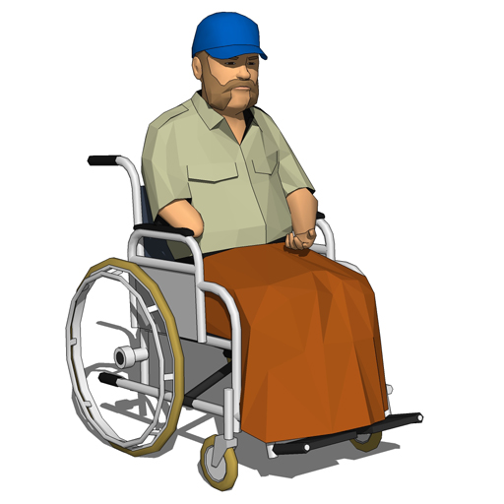
DISABILITY
  A disability is any condition of the body or mind that makes it difficult for a person to do certain activities and interact with their surrounding world.

Slide 4
DIFFERENT TYPES OF DISABILITIES
  Vision impairment
  Deaf or hard of hearing
  Mental health conditions
  Intellectual disability
  Acquired brain injury
  Autism spectrum disorder
  Physical disability

Slide 5
Technologies That Can Be Used To Help People With Special Needs
  Technologies that can be used to help people with special needs can be grouped into two;
  Adaptive technologies
  Assistive technologies

Slide 6
ADAPTIVE TECHNOLOGIES
  Adaptive technology refers to item or device specifically designed for people with disabilities.
Large print books
Good lighting
Large monitors
Software to adjust screen colors
Computers with voice output
Electronic mail
Word prediction software
Adjustable tables
Keyboard modifications, etc

Slide 7
Assistive Technology
  Assistive technology is something that makes accessing content better for everyone, e.g., include; Braille and Braille Embossers, adaptive keyboard, smart cane, etc

Slide 8
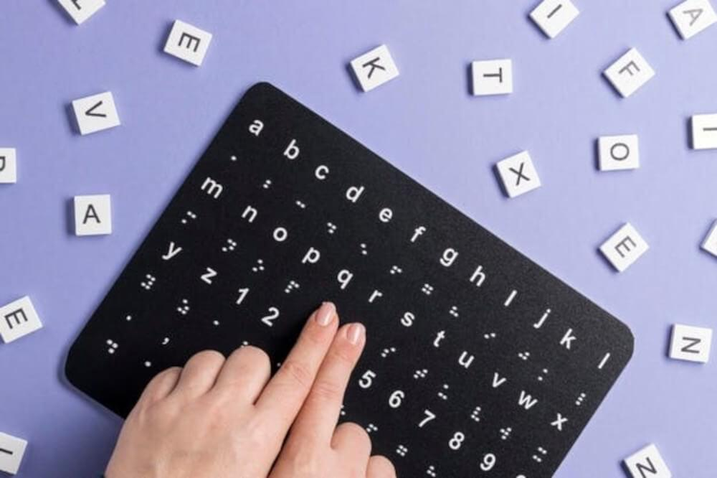
Adaptive Keyboards
This Keyboard for people with visual impairments look-alike braille keyboards.
They are well versed with comfort, speed, and accuracy while preventing issues like strain.

Slide 9
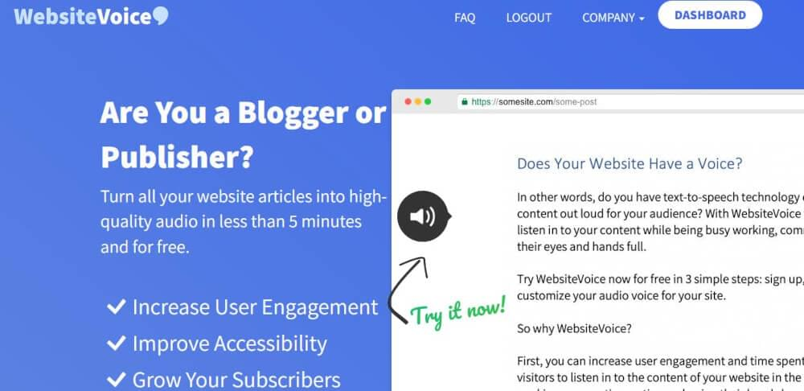
Text to speech software
Website Voice is an intelligent software to recognize text automatically and begins the audio conversion of the bulk of the text in a few minutes.

Slide 10
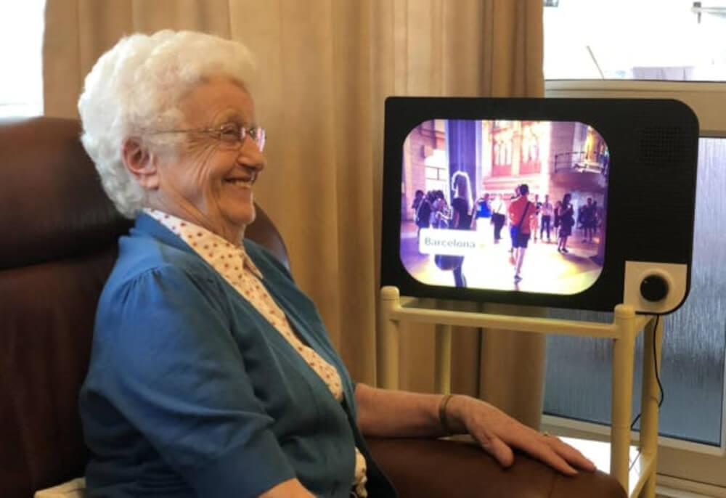
One-button computers
It is designed as both an entertainment and communication app.
By switching the device, the users can view calls, messages and answer video calls or look at the stuff their loved ones have sent via a large non-touch display

Slide 11
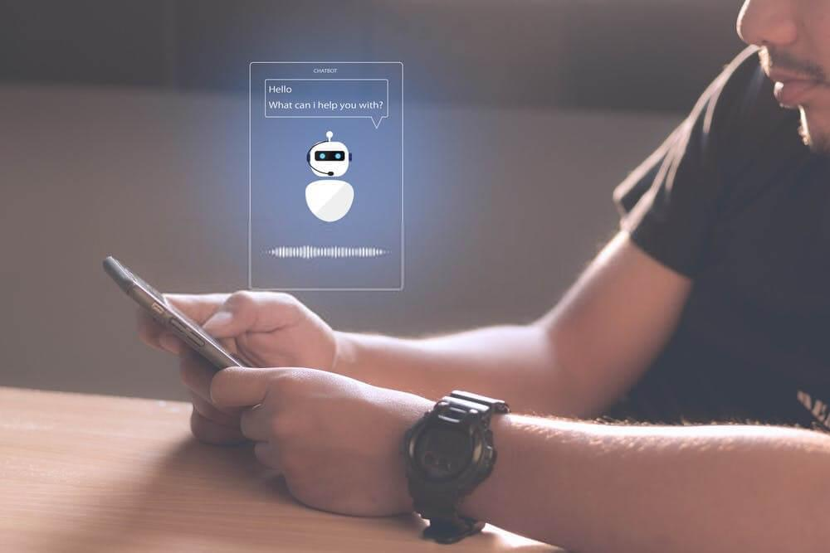
Voice assistants
The users can speak to a built-in voice assistant to command it to call people, send texts, update their schedules, make to-do lists, set alarms, play music, provide news and weather updates, buy things online, manage their smart devices, and many more.

Slide 12
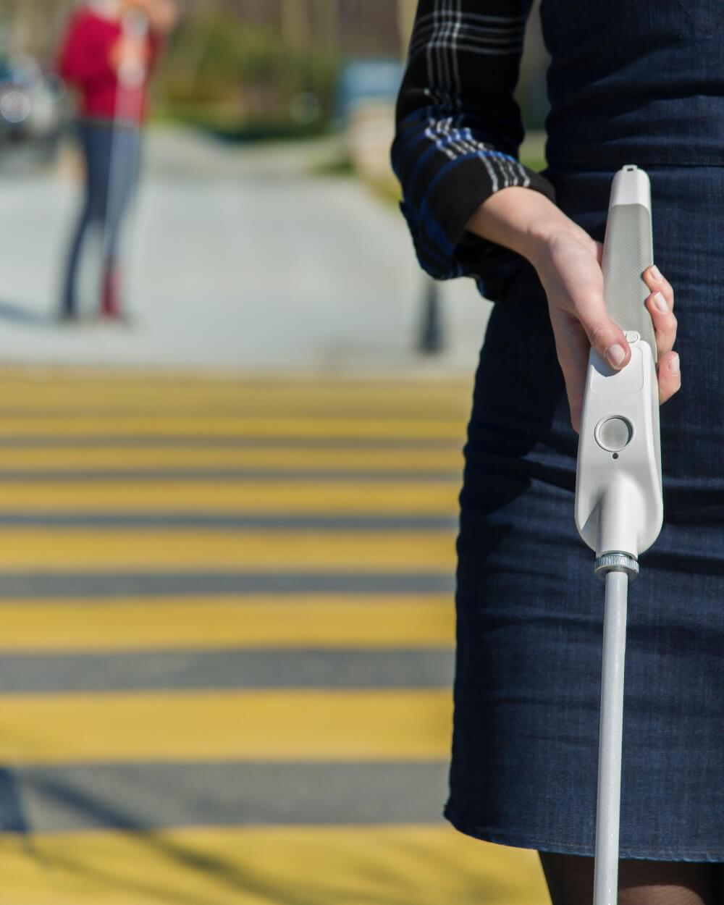
The smart cane
The smart cane have smart sensors that identify roadblocks, obstructions, and hindrances on streets, roads, and parks and alert the user.
Not only that, but the users can also connect their smart canes with their smart devices to find the different locations and receive information on public transportation.
They can get voice alerts to locate if they misplace their cane or phone.

Slide 13
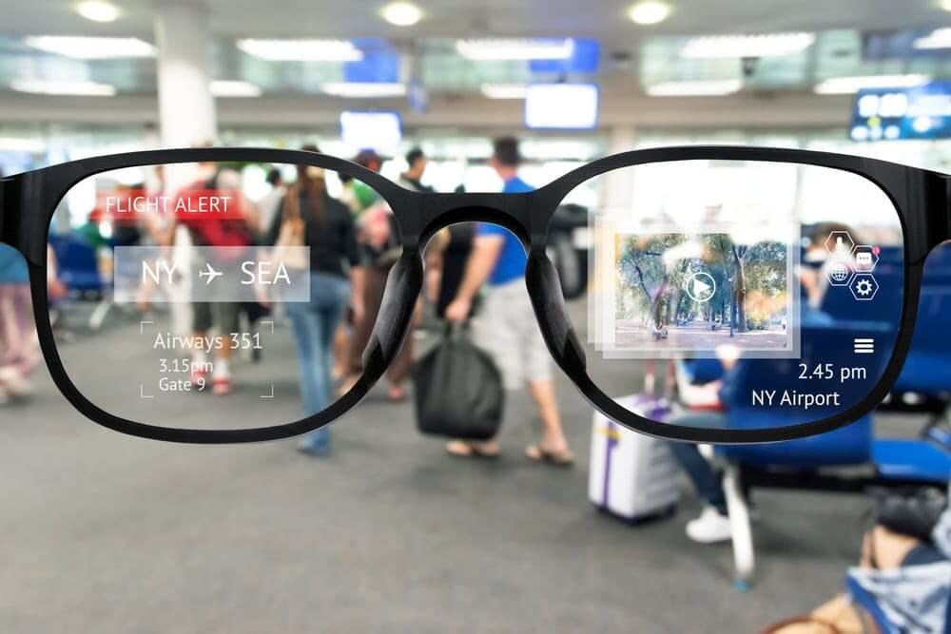
Smart Glasses as an Assistive Technology
This smart glasses that have the capability of navigation by just head movements.
These intelligent glasses are designed for electric wheelchair users to control and use a wheelchair.

Slide 14
Smart Glasses as an Assistive Technology
The process is typical, which involves connecting your smart devices with glasses to receive alarms, messages, calls, and notifications.
The smart sensors of the glasses automatically pick the head gestures and control the wheelchair accordingly.
Moreover, the user has the display at their right eyeglass frame and can access the navigation menu and take controls.
The users can take photos, share, adjust seat positions, and send emergency messages with the built-in camera.

Slide 15
Describe how portable computing devices affect our everyday lives.
Discuss portable computing devices that we use daily e.g. Mobile phones,
smart watches etc.
2. Describe how these devices affect our daily lives.

Slide 16
Portable Computing Devices
A potable computer is a computer designed to be easily moved from one place to another and includes a display and keyboard together.
Portable computing device can also be called mobile computing devices.
Examples include; Laptop, tablet, smartphone, smartwatch, etc.

Slide 17
Features of Laptop Computer
Usually battery powered
Has a screen that closes over the keyboard
Small enough to rest on the user’s lap.
Examples include;
Apple MacBook, Acer swift, Asus Vivo Book, etc.

Slide 18
Features of Tablet
A wireless portable personal computer
Has a touchscreen interface
Smaller than laptop
Has in-built battery that needs to be charged.
Examples; Apple iPad, Microsoft Surface and Samsung Galaxy Tab.

Slide 19
Features of Smart Phone
A smart phone has inbuilt battery that is charged.
Has a touchscreen interface
Can perform almost all functions of a computer.
Examples; Apple iPhone X, Samsung galaxy Note 8, Infinix hot 5, etc.

Slide 20
Effect of Portable Computing Devices
What are the positive and negative effect of these portable computing devices?

Slide 21
Positive effective of using Laptop Computers
Portable
Convenient
Improved performance
  Touchscreen
  Detachable screens

Slide 22
Negative effective of using Laptop Computers
Health risk
  Back , neck and shoulder pain
  Headaches
  Eye strain
  Overuse injuries of arms and hands
  Overheating
  Battery life degradation
  Expensive
  Exposure to inappropriate content
  Cyber bullying
  Virus attack

Slide 23
Positive effective of using tablet
Easy accessibility improves productivity
Affordable
Easy to control and secure

Slide 24
Negative effective of using tablet
Can easily get missing
Fragile hardware
Can be expensive in it use.

